Slide 1
Logistic Regression Part I: Binary Outcome Probability Models
Dr. Upender Subramanian
MKT/BUAN 6337

Slide 2
Brand Choice Example
Grocery store has data on items that individual customers bought on each purchase occasion over a period of time
We consider purchases that included Coke or Pepsi
We include information about prices, and whether one or both brands was promoted using an in-store display at the time of each purchase
We want to know how the relative price of Coke to Pepsi (price ratio) and in-store displays affect which brand that was bought

Slide 3
Brand Choice Example
Obs | Coke | disp_coke | disp_pepsi | pratio
1 | 1 | 0 | 0 | 0.63121
2 | 1 | 0 | 0 | 0.74302
3 | 1 | 0 | 0 | 0.55307
4 | 1 | 0 | 0 | 0.74302
5 | 1 | 0 | 0 | 1.00000
6 | 0 | 0 | 0 | 1.00000
7 | 0 | 0 | 1 | 1.50420
8 | 0 | 0 | 1 | 0.99048
9 | 0 | 1 | 1 | 1.00000
10 | 0 | 0 | 1 | 1.34587

Slide 4
Binary Outcome Models
Brand Choice / Share: Which brand will a shopper buy?
As function of prices, promotions
Data: Brand individual shoppers bought on past purchase occasions
Promotions: Which customers will respond to an offer?
As a function of customer characteristics
Data: How individual customers responded to a past offer
Churn / Retention: Which customers will cancel service?
As function of renewal offer, product bundle, competitive activity
Data: Whether individual customers canceled in previous months
Non-Marketing: Which email should be sent to spam folder? Which credit card transactions can be fraudulent?

Slide 5
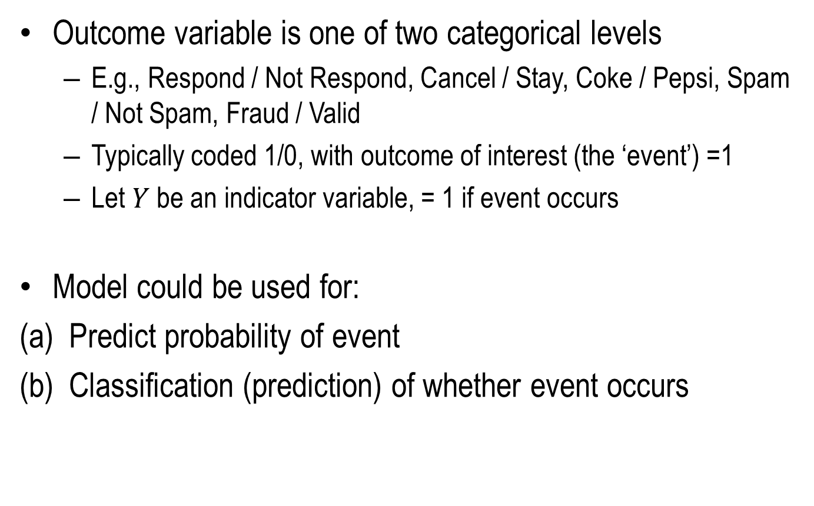
Binary Outcome Models
Outcome variable is one of two categorical levels
E.g., Respond / Not Respond, Cancel / Stay, Coke / Pepsi, Spam / Not Spam, Fraud / Valid
Typically coded 1/0, with outcome of interest (the ‘event’) =1
Let $Y$ be an indicator variable, = 1 if event occurs
Model could be used for:
Predict probability of event
Classification (prediction) of whether event occurs

Slide 6
Class Overview
Linear Probability Model
Problems with this approach
Logistic and Probit Probability Models
Model and Interpretation
Classification using Probability Models
Classification thresholds and Receiver Operating Curves (ROC)
Modeling Rare Outcomes

Slide 7
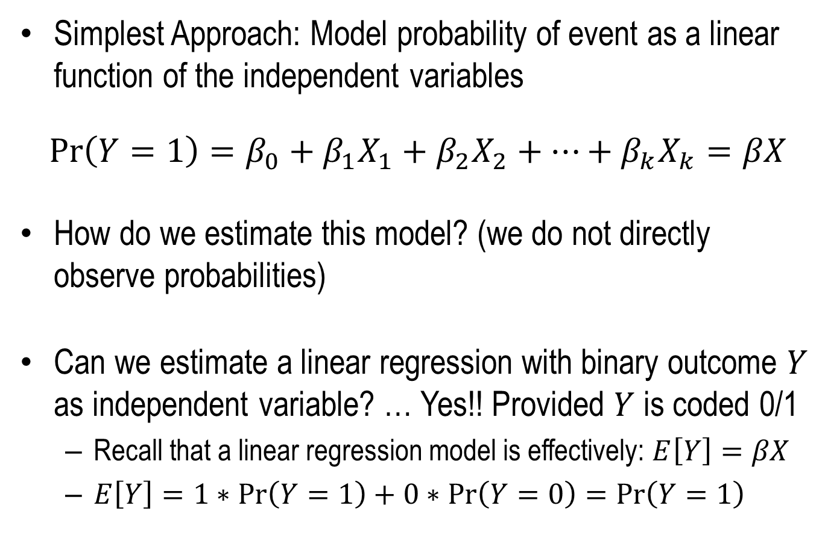
Linear Probability Models
Simplest Approach: Model probability of event as a linear function of the independent variables
$$\operatorname{Pr}\left(Y=1\right)=β_{0}+β_{1}X_{1}+β_{2}X_{2}+…+β_{k}X_{k}=βX$$
How do we estimate this model? (we do not directly observe probabilities)
Can we estimate a linear regression with binary outcome $Y$ as independent variable? … Yes!! Provided $Y$ is coded 0/1
Recall that a linear regression model is effectively: $E\left[Y\right]=βX$
$E\left[Y\right]=1∗\operatorname{Pr}\left(Y=1\right)+0∗\operatorname{Pr}\left(Y=0\right)=\operatorname{Pr}\left(Y=1\right)$

Slide 8
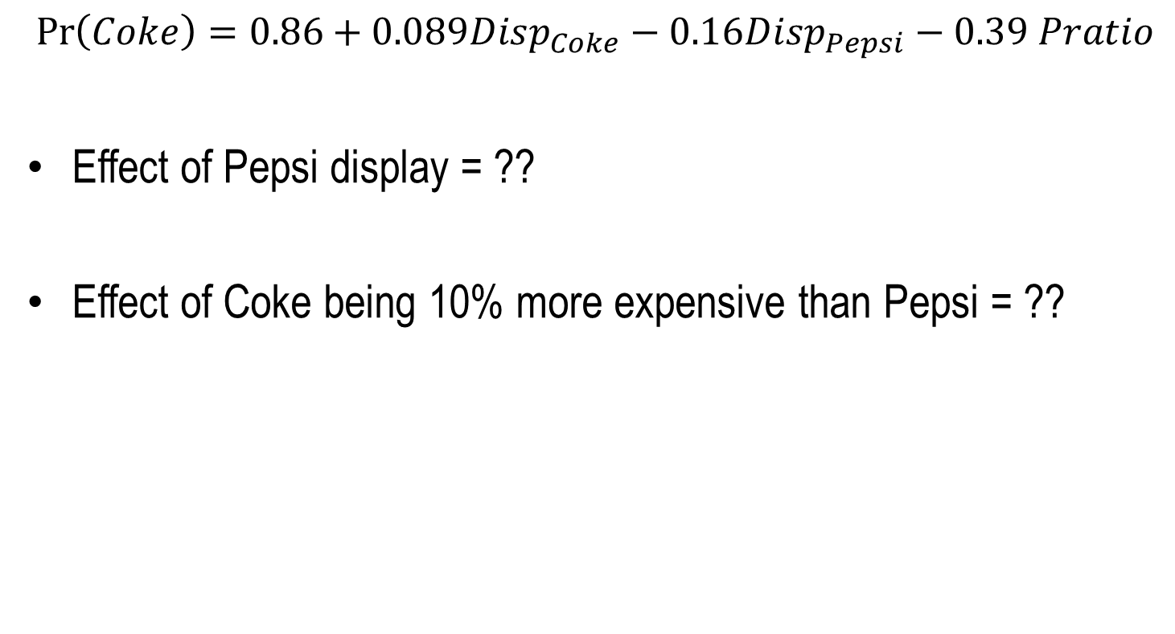
Brand Choice Example
$$\operatorname{Pr}\left(Coke\right)=0.86+0.089Disp_{Coke}−0.16Disp_{Pepsi}−0.39 Pratio$$
Effect of Pepsi display = ??
Effect of Coke being 10% more expensive than Pepsi = ??

Slide 9
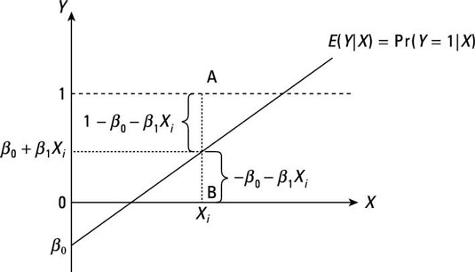
Problems with Linear Probability Model
Residual if observed Y=1
Residual if observed Y=0
Linear probability model cannot be taken literally
Can predict probabilities that are negative or larger than 1
Even if prediction is between 0 and 1
Residuals are not normal, homoscedastic
Not practical that unit change in X has the same impact whether the actual probability is low or high

Slide 10
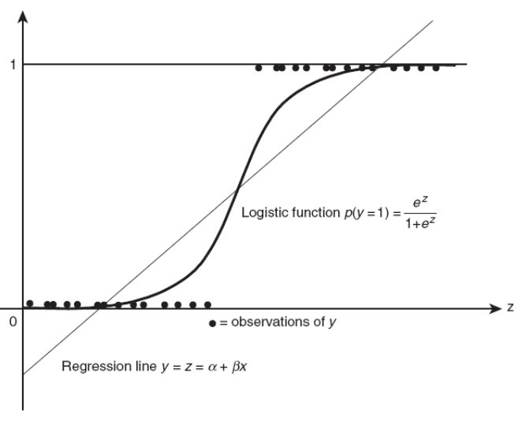
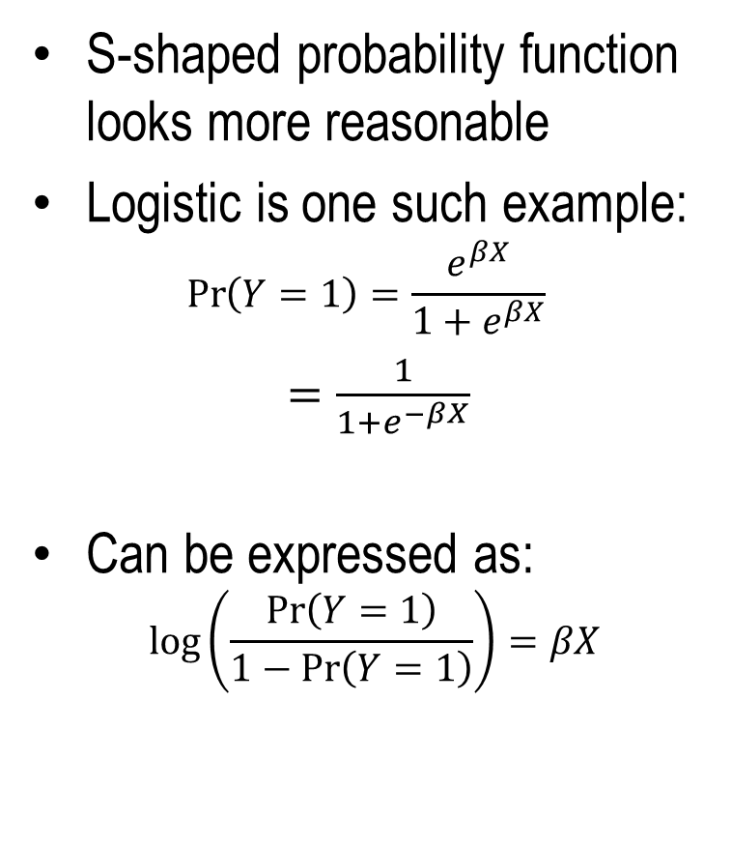

Logistic Regression
S-shaped probability function looks more reasonable
Logistic is one such example:
$$\operatorname{Pr}\left(Y=1\right)=\frac{e^{βX}}{1+e^{βX}}$$
$=\frac{1}{1+e^{−βX}}$
Can be expressed as:
$$\log\left(\frac{\operatorname{Pr}\left(Y=1\right)}{1−\operatorname{Pr}\left(Y=1\right)}\right)=βX$$
$logit(\operatorname{Pr}\left(Y=1\right))$

Slide 11
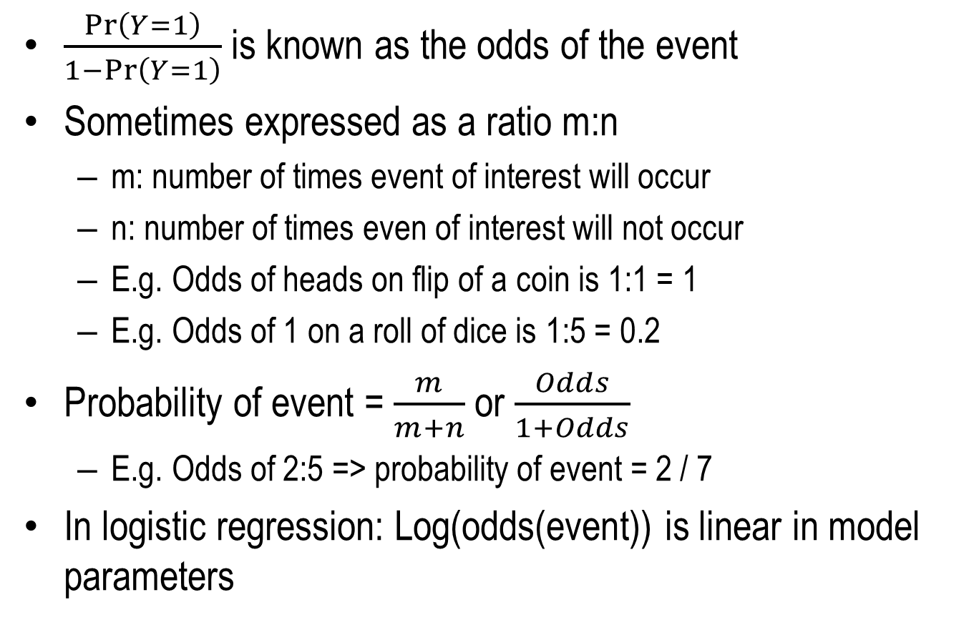
Odds of an Event
$\frac{\operatorname{Pr}\left(Y=1\right)}{1−\operatorname{Pr}\left(Y=1\right)}$ is known as the odds of the event
Sometimes expressed as a ratio m:n
m: number of times event of interest will occur
n: number of times even of interest will not occur
E.g. Odds of heads on flip of a coin is 1:1 = 1
E.g. Odds of 1 on a roll of dice is 1:5 = 0.2
Probability of event = $\frac{m}{m+n}$ or $\frac{Odds}{1+Odds}$
E.g. Odds of 2:5 => probability of event = 2 / 7
In logistic regression: Log(odds(event)) is linear in model parameters

Slide 12
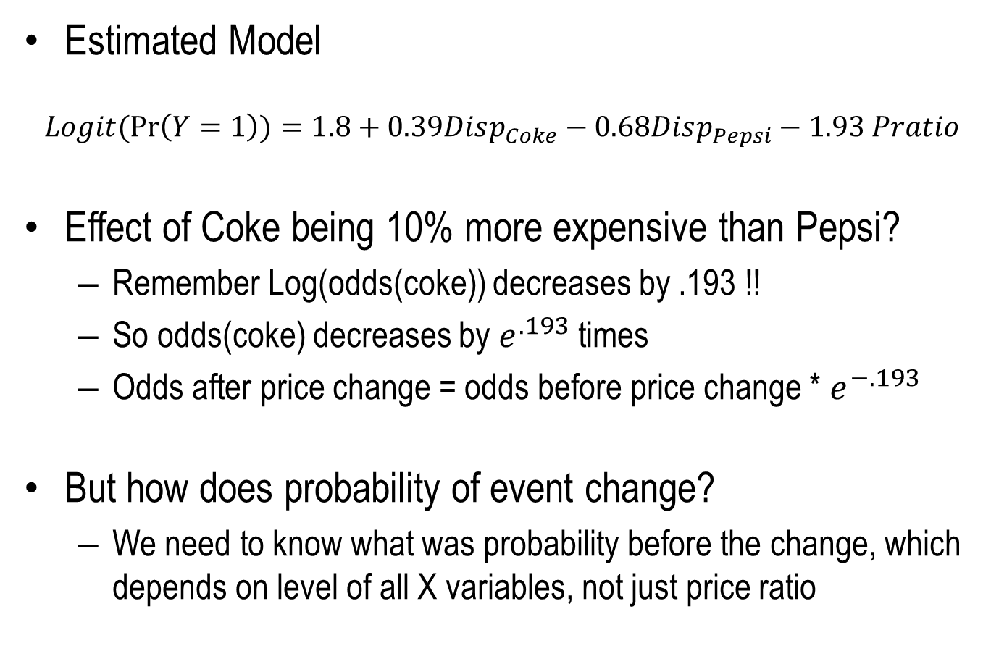
Brand Choice Example
Estimated Model
$$Logit(\operatorname{Pr}\left(Y=1\right))=1.8+0.39Disp_{Coke}−0.68Disp_{Pepsi}−1.93 Pratio$$
Effect of Coke being 10% more expensive than Pepsi?
Remember Log(odds(coke)) decreases by .193 !!
So odds(coke) decreases by $e^{.193}$ times
Odds after price change = odds before price change * $e^{−.193}$
But how does probability of event change?
We need to know what was probability before the change, which depends on level of all X variables, not just price ratio

Slide 13

Brand Choice Example
$$Logit(\operatorname{Pr}\left(Y=1\right))=1.8+0.39Disp_{Coke}−0.68Disp_{Pepsi}−1.93 Pratio$$
Change in probability depends on initial probability level
But Odds ratio (after by before) is always $e^{−.193}$

Slide 14

Brand Choice Example
$$Logit(\operatorname{Pr}\left(Y=1\right))=1.8+0.39Disp_{Coke}−0.68Disp_{Pepsi}−1.93 Pratio$$
Odds Ratio for $Disp_{Coke}$ is $e^{0.39}$, for $Disp_{Pepsi}$ is $e^{−0.68}$and $Pratio$ is $e^{−1.93}$
Odds Ratio Estimates
Effect | Point Estimate | 95% Wald Confidence Limits
disp_coke | 1.480 | 1.024 | 2.139
disp_pepsi | 0.506 | 0.342 | 0.749
pratio | 0.145 | 0.070 | 0.301

Slide 15
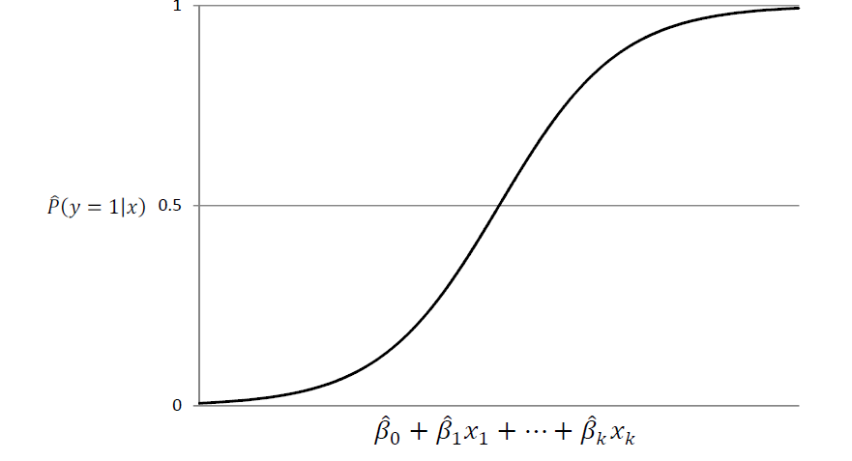

Marginal Effect on Probability
$$\frac{∂\operatorname{Pr}\left(Y=1\right)}{∂X}=β\operatorname{Pr}\left(Y=1\right)\left(1−\operatorname{Pr}\left(Y=1\right)\right)$$
Marginal effect is small if $\operatorname{Pr}\left(Y=1\right)$ is close to 0 or 1
Marginal effect is large if $\operatorname{Pr}\left(Y=1\right)$ is close to 0.5

Slide 16
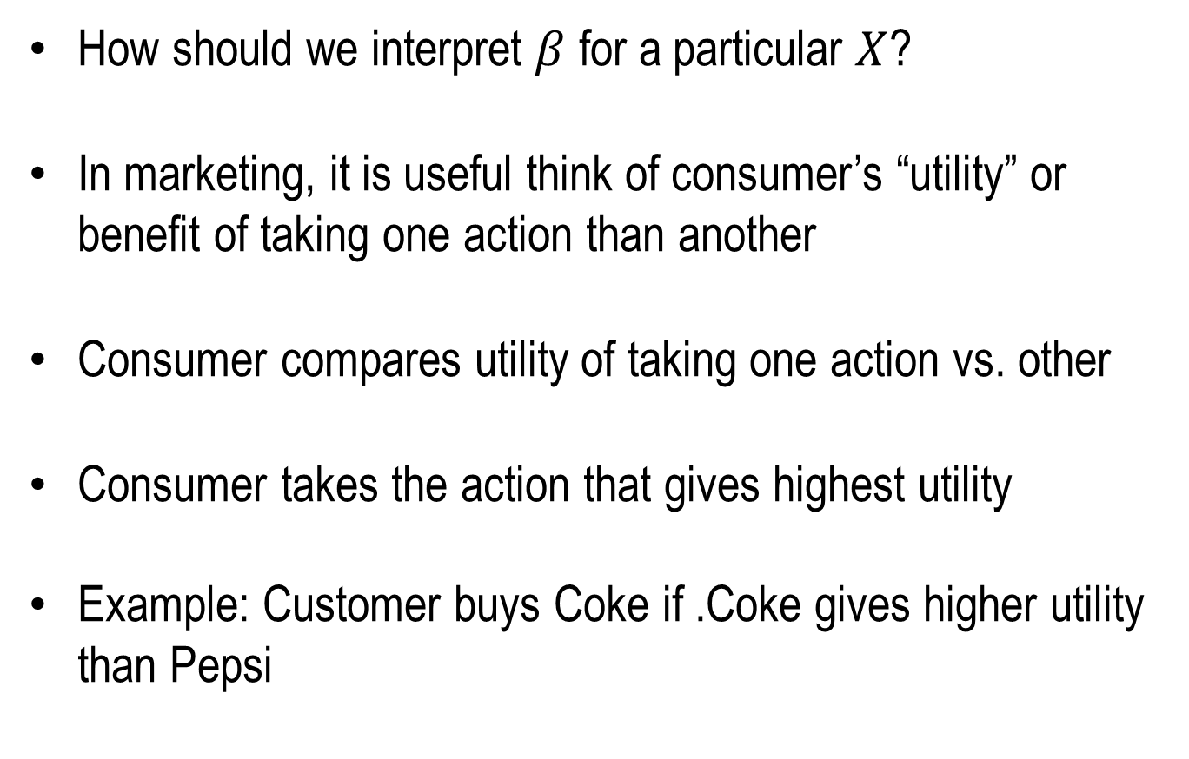
Latent Utility Interpretation
How should we interpret $β$ for a particular $X$?
In marketing, it is useful think of consumer’s “utility” or benefit of taking one action than another
Consumer compares utility of taking one action vs. other
Consumer takes the action that gives highest utility
Example: Customer buys Coke if .Coke gives higher utility than Pepsi

Slide 17
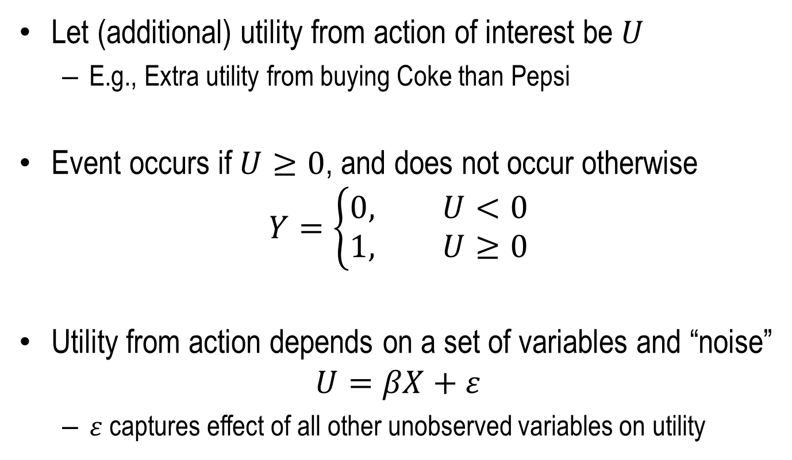
Latent Utility Interpretation
Let (additional) utility from action of interest be $U$
E.g., Extra utility from buying Coke than Pepsi
Event occurs if $U≥0$, and does not occur otherwise
$$Y=\left\{\begin{aligned}0, U<0 \\ &1, U≥0\end{aligned}\right.$$
Utility from action depends on a set of variables and “noise”
$$U=βX+ε$$
$ε$ captures effect of all other unobserved variables on utility

Slide 18
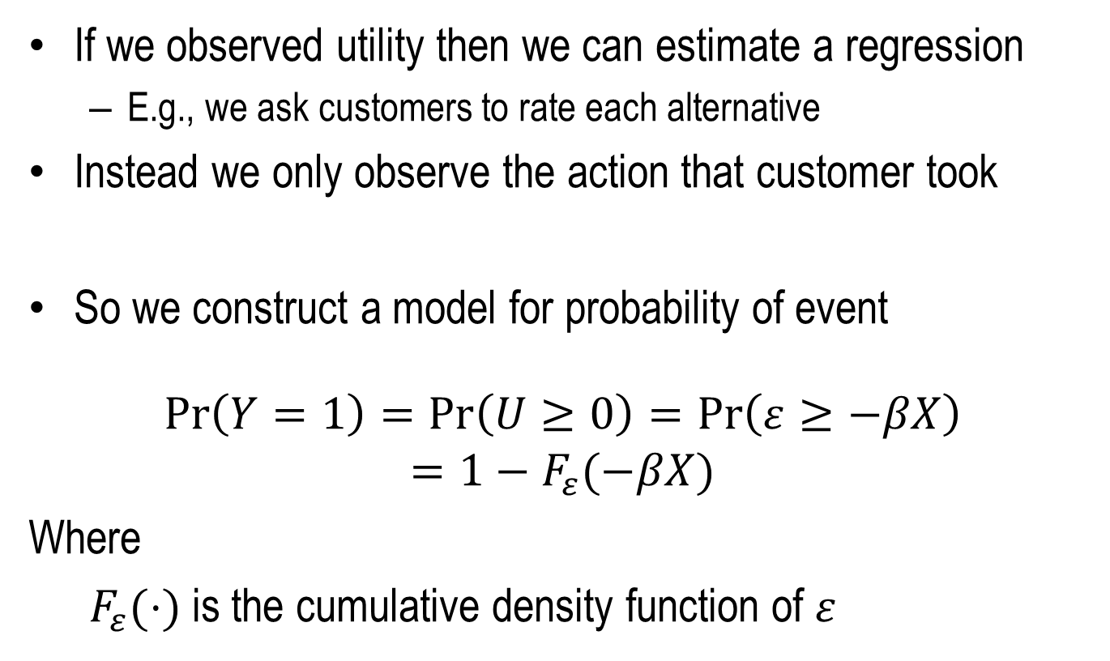
Latent Utility Interpretation
If we observed utility then we can estimate a regression
E.g., we ask customers to rate each alternative
Instead we only observe the action that customer took
So we construct a model for probability of event
$$\operatorname{Pr}\left(Y=1\right)=\operatorname{Pr}\left(U≥0\right)=\operatorname{Pr}\left(ε≥−βX\right)$$
$$=1−F_{ε}(−βX)$$
Where
$F_{ε}(⋅)$ is the cumulative density function of $ε$

Slide 19
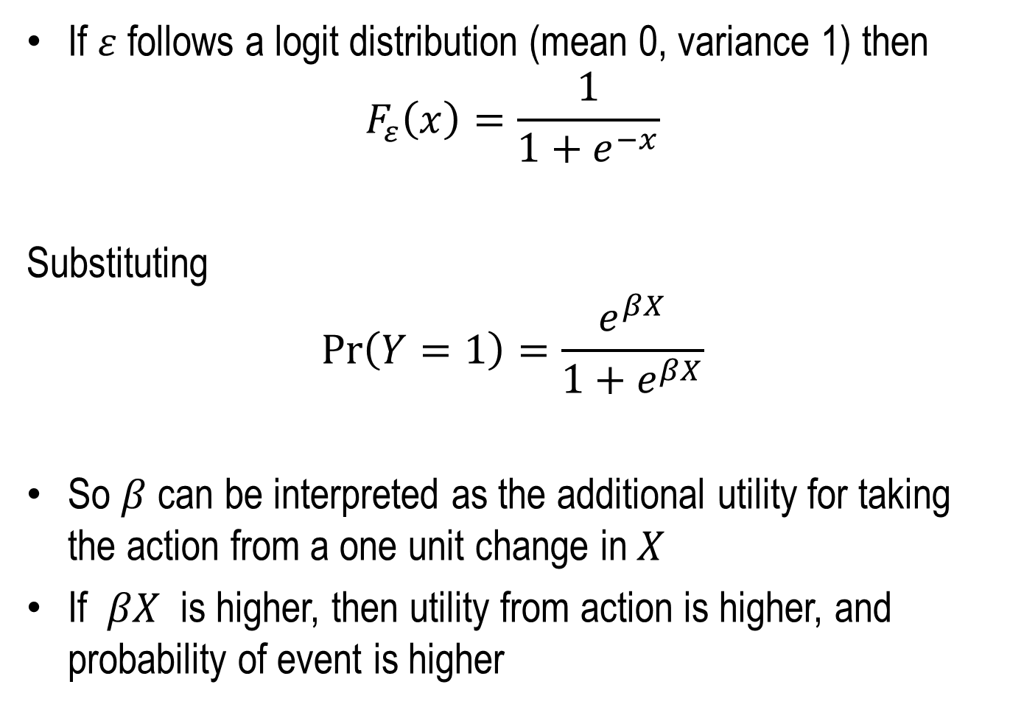
Latent Utility Interpretation
If $ε$ follows a logit distribution (mean 0, variance 1) then
$$F_{ε}\left(x\right)=\frac{1}{1+e^{−x}}$$
Substituting
$$\operatorname{Pr}\left(Y=1\right)=\frac{e^{βX}}{1+e^{βX}}$$
So $β$ can be interpreted as the additional utility for taking the action from a one unit change in $X$
If $βX$ is higher, then utility from action is higher, and probability of event is higher

Slide 20
Utility and Brand Loyalty Example
Suppose we have three segments
Coke loyals: generally tend to prefer coke
Pepsi loyals: generally tend to prefer pepsi
Switchers: Indifferent, keep switching between brands
Who should we give a price discount to?
Coke loyals derive high utility from Coke
Pepsi loyals derive low utility from Coke
Switchers are indifferent => moderate utility from Coke

Slide 21
Utility and Brand Loyalty Example
Coke Loyals
Switchers
Pepsi Loyals
Logistic regression captures fact that when latent utility is high or low, then marginal effect is small
Marginal effect of price cut will be highest for switchers
In a linear probability model, marginal effect will be same!!

Slide 22
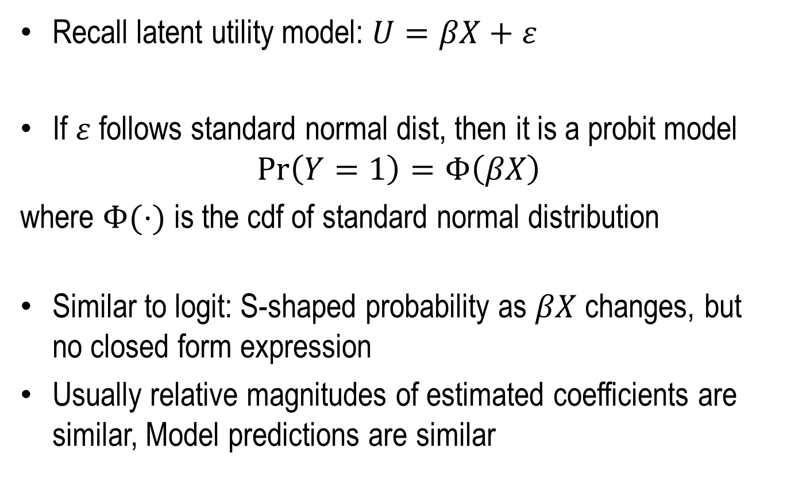
Probit Model
Recall latent utility model: $U=βX+ε$
If $ε$ follows standard normal dist, then it is a probit model
$$\operatorname{Pr}\left(Y=1\right)=Φ\left(βX\right)$$
where $Φ(⋅)$ is the cdf of standard normal distribution
Similar to logit: S-shaped probability as $βX$ changes, but no closed form expression
Usually relative magnitudes of estimated coefficients are similar, Model predictions are similar

Slide 23
Model Specification: Independent Variables
Similar to what we saw for linear regression
Can use indicator variables, interaction terms, non-linear functions of variables
Incorporate segments through indicator variables and interaction effects

Slide 24
Model Evaluation and Selection
Similar to what we saw in the case of linear regression
In-sample: Log-likelihood, AIC, BIC...
Out-of-sample: Classification errors, ROC curve
Use cross-validation for model building, Test sample for evaluating final model performance
Selection: Forward, Backward, Stepwise

Slide 25
Logistic Regression Part II: Classification & Modeling Rare Events
Dr. Upender Subramanian
MKT/BUAN 6337

Slide 26
Classification
Sometimes goal is not to predict probability of outcome but to perform a classification (to take an action)
Customer Retention Example: AT&T wants to identify customers who are at risk of canceling their service and proactively contact them
Make courtesy calls to customers classified as likely to leave
Enquire satisfaction, offer suggestions / solutions
Targeted Promotion Example: Amazon wants to send discount offers to consumers to stimulate sales.
Which customers should be contacted / targeted?
Other examples: which email is spam, which transaction can be fraudulent?

Slide 27
Classification
Build a probability model for event of interest
Rank customers based on their predicted probabilities
Set a threshold probability level (e.g., 0.6)
Select customers who are above this threshold
How do we set the threshold? Why not target / contact all customers?
Need to balance costs and benefits of contacting

Slide 28
Classification Matrix & Accuracy Measures
Total Accuracy = (TP+TN)/(TP+TN+FP+FN) can be misleading
If event is rare (1%) then always predicting non-event will have high (99%) accuracy
Sensitivity = TP/(TP+FN) (% of true positive correctly accepted)
Aka True positive rate
Specificity= TN/(TN+FP) (% of true negative correctly rejected)
False positive rate = 1 – Specificity = FP/(TN+FP)

Slide 29
Visual Perspective
Threshold Probability Level
Frequency distribution of customers who will not cancel
Frequency distribution of customers who will cancel
True Negative
True Positive
0
Predicted Probability of Cancelation
1
False Negative
False Positive
Notes:
For example, let's pretend you built a classifier to predict whether paper will be admitted to a journal.
The features might be the number of authors, the number of papers those authors have previously submitted to the journal, et cetera. The response (or "output variable") would be whether or not the paper was admitted.
We'll pretend that every blue and red pixel represents a paper for which you want to predict the admission status. This is your validation (or "hold-out") set, so you know the true admission status of each paper. The 250 red pixels are the papers that were actually admitted, and the 250 blue pixels are the papers that were not admitted.
Since this is your validation set, you want to judge how well your model is doing by comparing your model's predictions to the true admission statuses of those 500 papers. We'll assume that you used a classification method such as logistic regression that can not only make a prediction for each paper, but can also output a predicted probability of admission for each paper.
Let's examine this plot in detail. The x-axis represents your predicted probabilities, and the y-axis represents a count of observations, kind of like a histogram. Let's estimate that the height at 0.3 is 10 pixels. This plot tells you that there were 10 papers for which you predicted an admission probability of 0.3, and the true status for all 10 papers was negative (meaning not admitted). There were about 50 papers for which you predicted an admittance probability of 0.5, and 20 of and of those were admitted and the other 30 were not. There were 10 papers for which you predicted a probability of 0.9, and all of those were admitted. And so on.

Slide 30
ROC Curve Example
Threshold = 0.9
Threshold = 0.55
10 observations
True classification: 5 positive (y=1), 5 negative (y=0)
Sorted in descending order of a predicted probability
Calculate sensitivity, 1-specificity for each threshold
Notes:
As we move the classifier to the right (classifier increases) – TP goes down and TP ratio goes down.
We will classify fewer observations that are positive correctly.
Similarly, False positive ratio goes down.

Slide 31
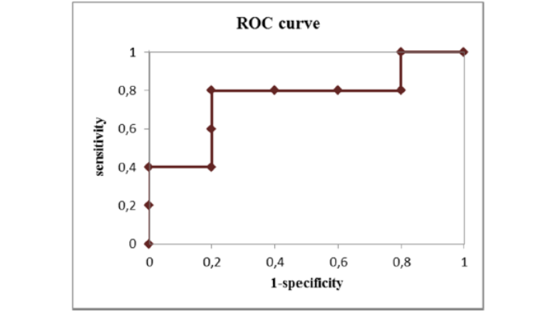
ROC Curve Example
ROC curve is plot of True Positive Rate (on y-axis) versus the False Positive Rate (on x-axis) for every possible classification threshold.
Notes:
ROC curve starts at the 1,1 point.
Ends at (0,0)

Slide 32
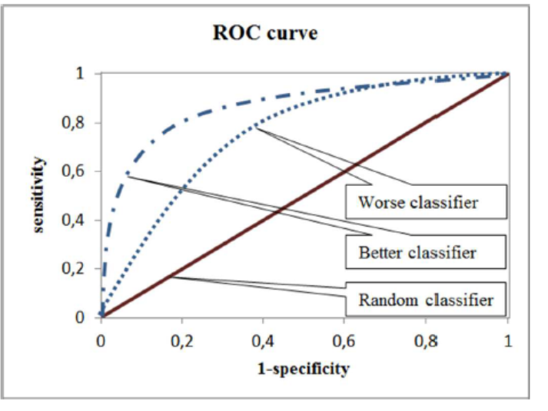
ROC Curves and Classification Performance
Random classifier: Classify x% randomly as positive
Sensitivity = x / 100, Specificity = 1 – x / 100
Closer you get to top left corner, better the classification
Notes:
A more general curve:
With more observations the curve will become smoother.
The diagonal line y = x represents the strategy of randomly guessing a class. For example, if a classifier randomly guesses the positive class half the time, it can be expected to get half the positives and half the negatives correct; this yields the point (0.5, 0.5) in ROC space. If it guesses the positive class 90% of the time, it can be expected to get 90% of the positives correct but its false positive rate will increase to 90% as well, yielding (0.9, 0.9) in ROC space. Thus a random classifier will produce a ROC point that ‘‘slides’’ back and forth on the diagonal based on the frequency with which it guesses the positive class. In order to get away from this diagonal into the upper triangular region, the classifier must exploit some information in the data

Slide 33
Selecting the Threshold
If events and non-events are equally likely AND costs are same for false positive and false negative then choose point tangent to 45° line closest to top left corner

Slide 34
Selecting the Threshold
What if incidence rates of event/non-events differ, or costs for false positive and negatives differ?
E.g., Predicting whether a credit card transaction might be fraudulent and should be reviewed by credit card holder.
On the one hand incidence of fraudulent transaction is very low
On the other hand, cost of false negative is much higher than cost of false positive
Business decision might be to set the threshold very low that will result in a lot of false positives
But that might be considered acceptable because it would maximize the true positive rate and thus minimize the number of cases in which a real instance of fraud was not flagged for review.

Slide 35
Selecting the Threshold
If incidence rates of events and non-events differ then place more weight on getting whichever is more likely right
If costs of false positive and negative are different, then weight them accordingly
Cost of false positive = What is the NET LOSS from classifying as positive instead of negative
Cost of false negative = What is the NET LOSS from classifying as negative instead of positive
If actual cost is not known then assign relative costs: What type of mistake is more costly and roughly by how many times?

Slide 36
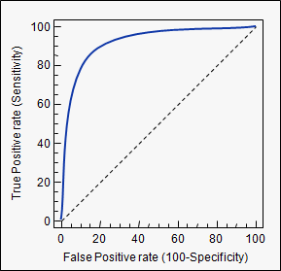
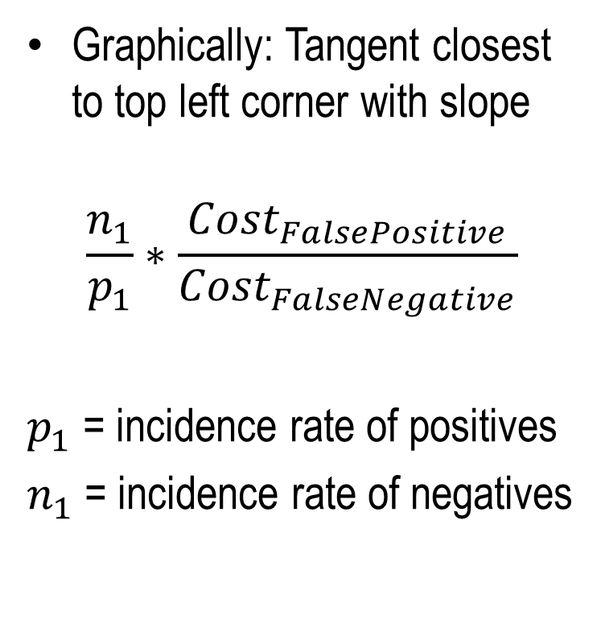
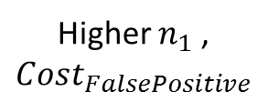
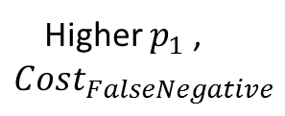
Selecting the Threshold
Graphically: Tangent closest to top left corner with slope
$$\frac{n_{1}}{p_{1}}∗\frac{Cost_{FalsePositive}}{Cost_{FalseNegative}}$$
$p_{1}$ = incidence rate of positives
$n_{1}$ = incidence rate of negatives
Higher $n_{1}$ , $Cost_{FalsePositive}$
Higher $p_{1}$ , $Cost_{FalseNegative}$

Slide 37
Selecting the Threshold
Customer Retention Example
Net Cost of False Positive: Wasted phone call, customer time
Net Cost of False Negative: Customer business is lost
Obtain relative costs from manager
For each threshold
Calculate classification matrix for test / validation sample
Calculate Total cost = FP * FPCost + FN * FNCost
Choose threshold that minimizes total cost

Slide 38
Modeling of Rare Outcomes
Logistic regression uses Maximum Likelihood Estimation to estimate coefficients
If number of events / non-events is too few (in absolute number) then MLE estimates are biased
IMPORTANT: “Rare” or sparse events is in absolute number of occurrences, not %
E.g. 1000 events in 100,000 observations may be ok, 10 events in 1000 observations is not ok
Rule of thumb: 20 events per independent variable in model

Slide 39
Approach 1: Over Sampling
Step 1: Randomly select subset of observations, with higher probability of choosing observations with event (Y=1)
Use PROC SURVEYSELECT, or your own data step
Do the reverse if non-event is rare
E.g., Original data: 5% events, 95% events, Oversampled data: 20% events, 80 % nonevents
Step 2: Estimate logistic regression on oversampled data
MLE estimates are less biased for the oversampled data

Slide 40
Approach 1: Over Sampling
But we want estimated model for original data
Can be shown theoretically that: Estimated model will have “correct” slope coefficients for original data
But intercept is biased since the base probability of event has increased
Not a problem for classification (intercept does not affect ranking of predicted probabilities)
For predicting probability of outcome, need to apply a correction factor for the intercept

Slide 41
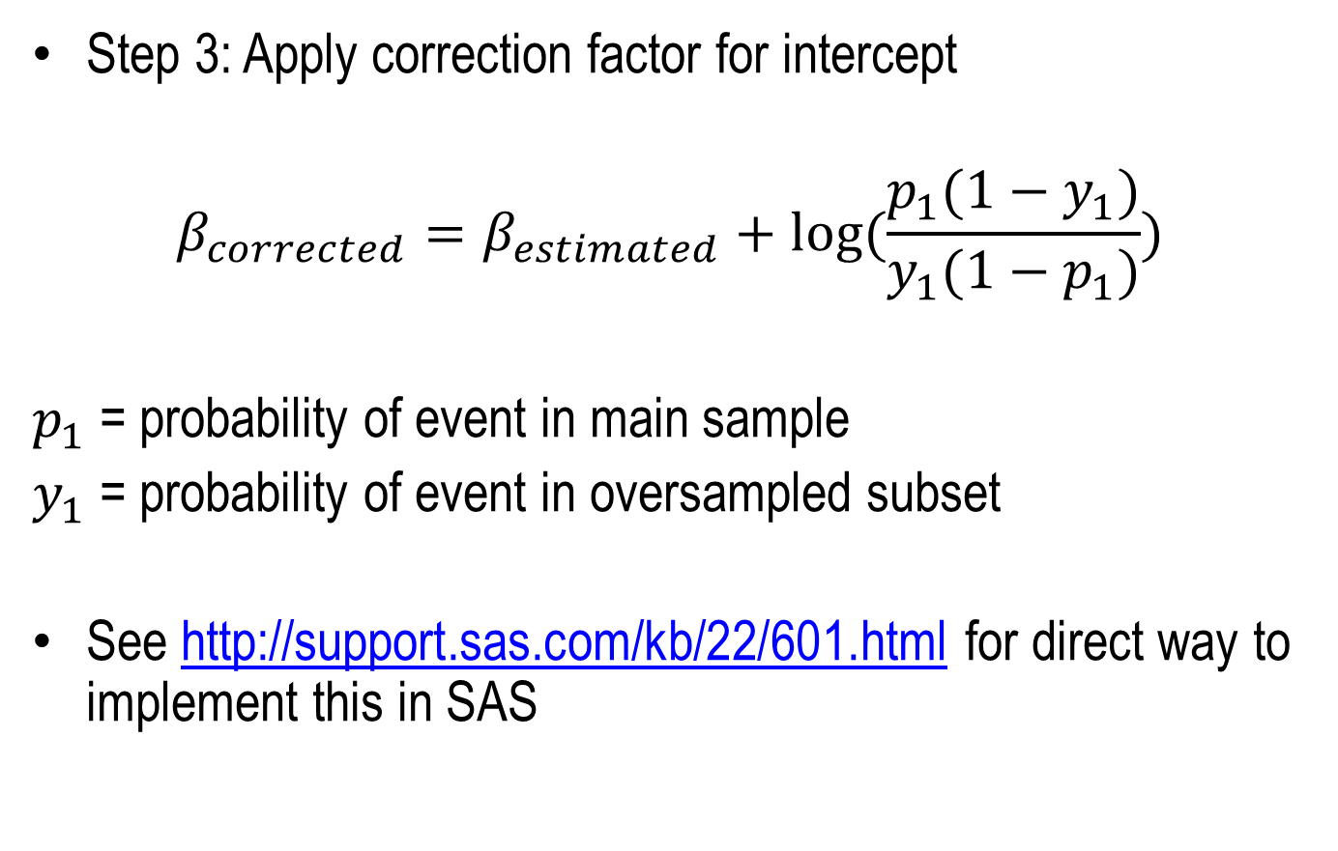
Approach 1: Over Sampling
Step 3: Apply correction factor for intercept
$$β_{corrected}=β_{estimated}+log⁡(\frac{p_{1}(1−y_{1})}{y_{1}(1−p_{1})})$$
$p_{1}$ = probability of event in main sample
$y_{1}$ = probability of event in oversampled subset
See http://support.sas.com/kb/22/601.html for direct way to implement this in SAS

Slide 42
Approach 2: Penalized MLE
SAS and other software support another estimation techniques that is more robust to small samples and rare events
Firth’s penalized MLE approach
More general than for logit
Implemented in SAS (option in model statement)
No need to oversample data

